Slide 1

Training Subset Selection for Weak Supervision
Presented by Sam Pease
Based on the paper by Hunter Lang, Aravindan Vijayaraghavan, and David Sontag

Slide 2
Intro
Obtaining large amounts of labeled data is hard. So many supervised models use Weak Supervision
Weak Supervision uses “labeling functions” to label data for the eventual model
Labeling functions are often simple and inaccurate
Nearly all weak supervision approaches use all labeled data to train the model
Using a subset of labeled data of highest quality produces better training data
Exploring coverage vs precision of psuedolabels

Slide 3
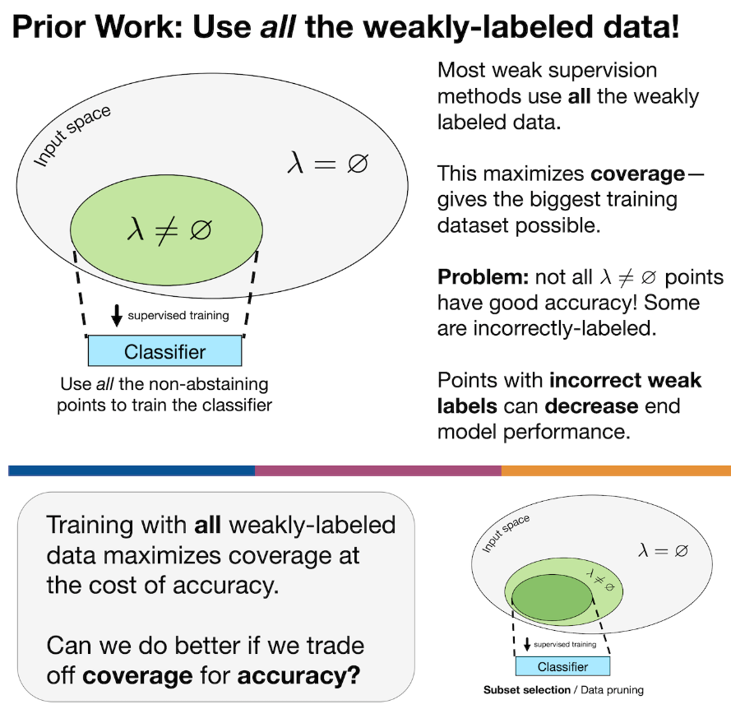

Slide 4


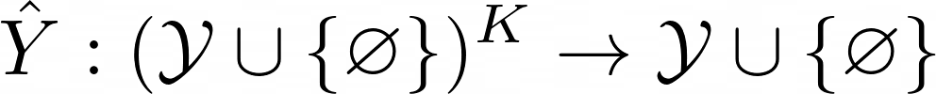
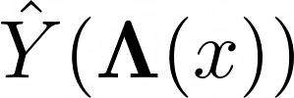
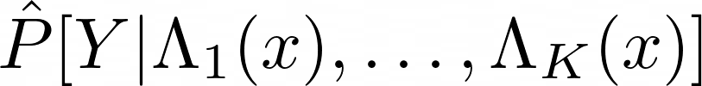
Background on Weak Supervision
3 components: labeling functions, label model, end model
Label functions are maps where represents abstention
The label model is a map such that if then is a single pseudolabel for x based off of all label functions
Simplest label model is majority vote:
Many label models output a “soft” pseudolabel, i.e. a distribution
The end model is a supervised model using the training set
Notes:
Example of basic weak supervisions model with sentiment analysis
Lambda_1 = {1 if text contains “good”, \varnothing if not}
Lambda_2 = {-1 if text contains “bad”, \varnothing if not}

Slide 5
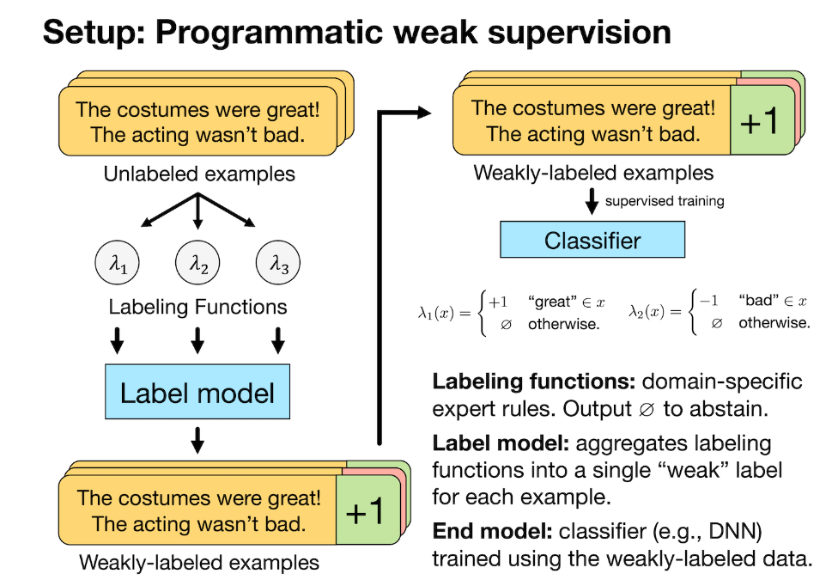
Example of Weak Supervision

Slide 6




Subset Selection methods
Two methods: entropy scoring and cut statistic
In both cases we construct by ranking all the data in and selecting the top fraction
Here is a hyperparameter tuned with a validation set

Slide 7
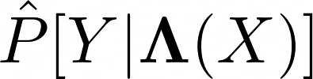
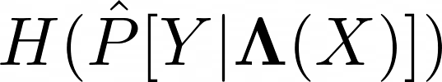
Entropy Score
Only works on label models that output a soft pseudolabel
Rank examples by the Shannon entropy of the soft label
Examples with lowest entropy are ranked the highest
The label model is “most confident” on low entropy examples if calibrated well

Slide 8

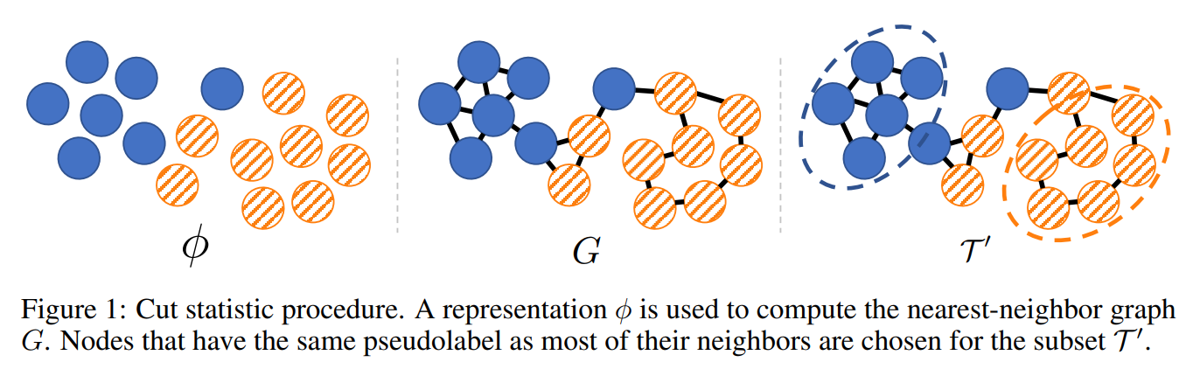
Cut Statistic
Depends on a good representation of input data
Create Graph G connection nearest neighbors in data
Call an edge between data points cut if neighboring data differs in label
Data with fewer cut edges have greater confidence in labeling
Construct with the best labeled data

Slide 9
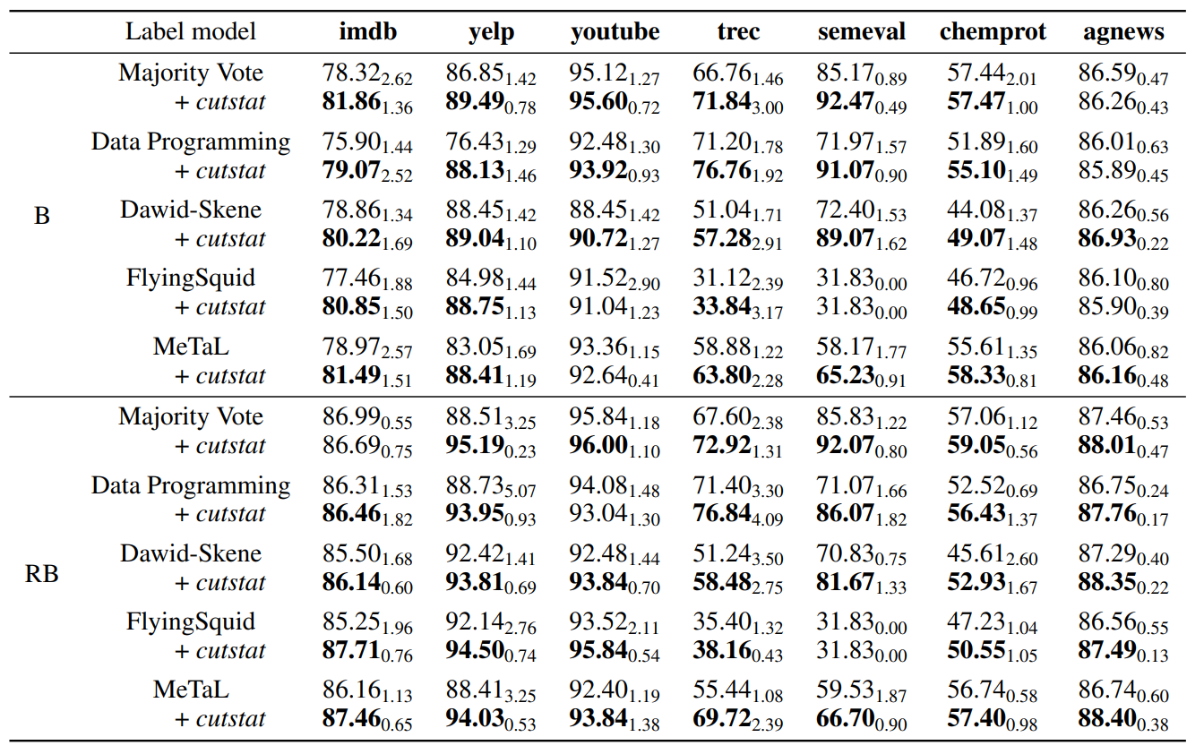
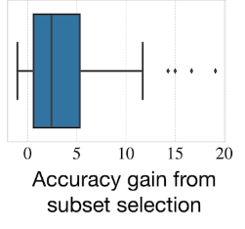
Results
Improves over using all the data for every label model.
Gains can be very large (up to 19%)
B and RB here represent BERT and RoBERT end models to create representation of data

Slide 10
Discussion
Why not relabel pseudolabeled data instead of throwing it out
Often makes the data worse
Empirically shown in paper’s appendix
Choosing a subset of data is changing the distribution of data
May be only selecting for “easy” examples
The above problem is already present in weakly supervised models
More work to be done on theoretical understanding why models can work well on uncovered data

Slide 11
Related Work
Selecting a subset of high-quality data has a long history referred to as data pruning
This work does not consider this case of pseudolabels coming from labeling functions
Many of these approaches use iterative learning or a modified loss function
Weak supervised learning does not typically have the above features
Cut statistic has been used for identifying mislabeled data in a training dataset

